Slide 1
Training Review
CMOS DESIGN

Slide 2

Contents
CMOS – Structure and operation
Inverter – the Not logic gate
Others CMOS design
Width/Length – Voltage - Temperature
CMOS Memory

Slide 3
CMOS Structure and Operation
B
S
G
D
D
G
S
B
p+
n+
n+
p+
p+
n+
NMOS
n-well
p type wafer
PMOS
D
S
G
B
G
B
S
D
NMOS
PMOS

Slide 4
CMOS Structure and Operation
NMOS structure
Poly (Gate)
G
G
G
NMOS
B
S
D
p+
n+
n+
p substrate
W/2
Cross section of an MNOS transistor
Thin Oxide (SiO2)
Width (W)
Length (L)

Slide 5
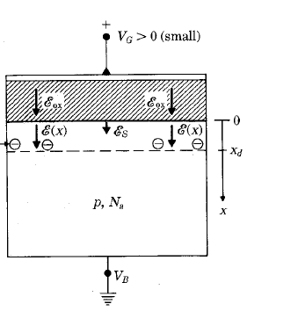
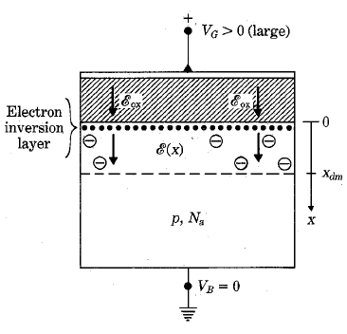
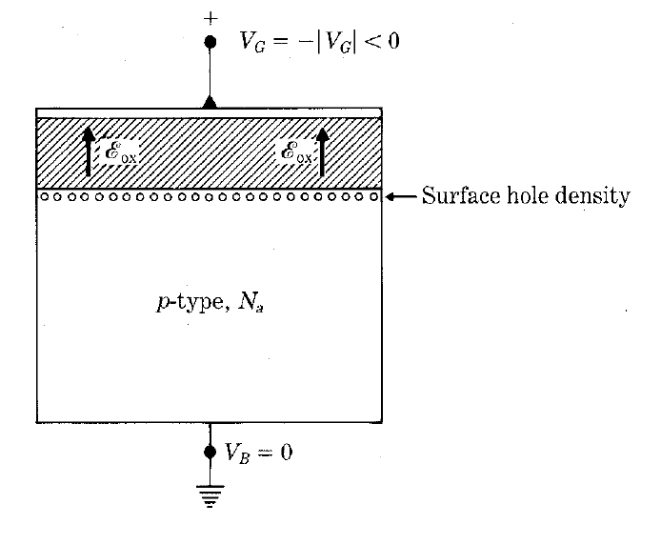
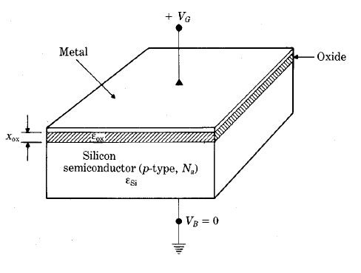
CMOS Structure and Operation
NMOS operation depend on Gate voltage
1. Accumulation
Accumulation
Depletion
Inversion
2. Depletion
V_{T}
3. Inversion
Increase V_{G}

Slide 6
CMOS Structure and Operation
NMOS operation modes
1. Cutoff : V_{GS} < V_{T}
2. Nonsaturation : V_{GS} ≥ V_{T} and V_{DS} ≤ (V_{GS} – V_{T})
3. Saturation : V_{GS} ≥ V_{T} and V_{DS} ≥ (V_{GS} – V_{T})

Slide 7
CMOS Structure and Operation
V_{S}=0
0<V_{gS}<V_{T0}
V_{D}=0
+ + + + + + + + + + + + + + + + + + + + +
NMOS operation modes
n+
Depletion
n+
p- subtrate
ID
In linear mode, MOS acts like a resistor varying linear with V_{GS}
Vb=0
V_{S}=0
0<V_{T0}<V_{gS}
V_{D}=0
+ + + + + + + + + + + + + + + + + +
n+
electron layer
Depletion
n+
VDS
p- subtrate
Vb=0
V_{S}=0
0<V_{T0}<V_{gS}
V_{DS}<(V_{gS}-V_{T0})
+ + + + + + + + + + + + + + + + + +
n+
Depletion
n+
I_{D}
p- subtrate
Saturation
Vb=0
Non-Linear
V_{S}=0
0<V_{T0}<V_{gS}
V_{DS}>(V_{gS}-V_{T0})
+ + + + + + + + + + + + + + + + + +
L-ΔL
ΔL
Linear
V_{DS}

Slide 8
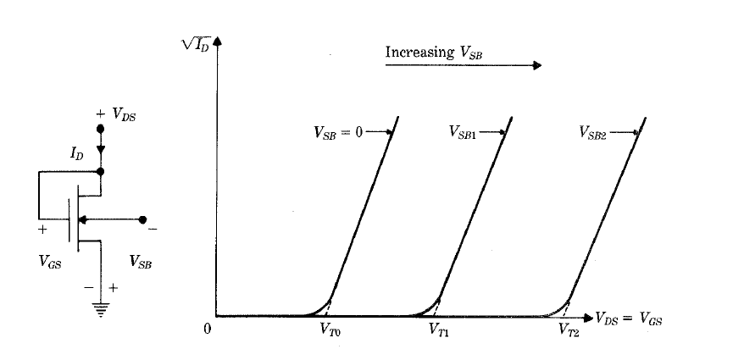
CMOS Structure and Operation
NMOS – V threshole
Vb=0 VT = VT0
VT0 phu thuoc the Fermi, nong do doping Na, hang so dien moi Si, Dien dung gate / chieu dai gate Cox
Delta VT tang khi tang VB.

Slide 9
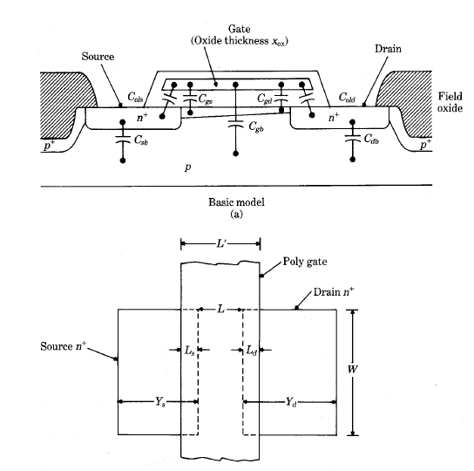
CMOS Structure and Operation
Overlap Capacitors in Mosfet
C_{ols} = C_{ox}WL_{s}
C_{old} = C_{ox}WL_{d}

Slide 10
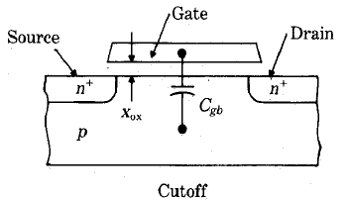
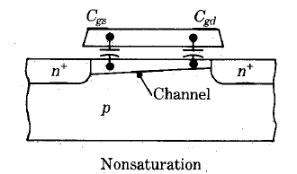
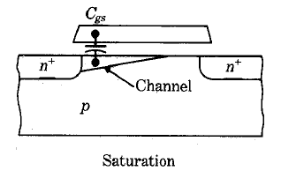
CMOS Structure and Operation
Gate Capacitors in Mosfet
1. Cutoff: no inversion layer channel
2. Nonsaturation:
3. Saturation:

Slide 11
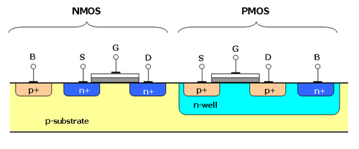
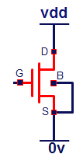
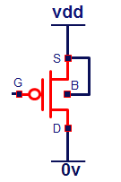
CMOS Structure and Operation
NMOS vs PMOS
V_{DS}>0
V_{gS}<0
I_{D}
I_{D}
V_{gS}>0
V_{DS}<0

Slide 12
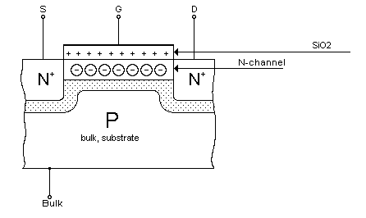
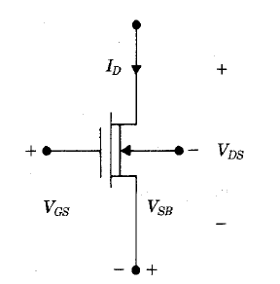
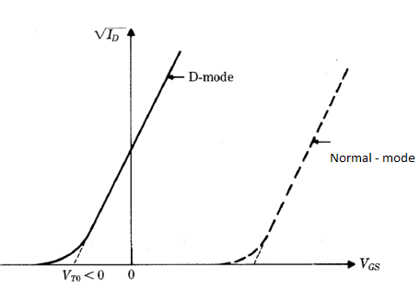
CMOS Structure and Operation
Depletion n-channel Mosfet

Slide 13
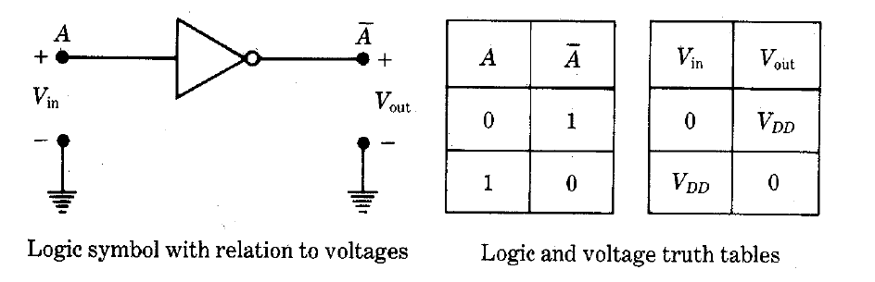
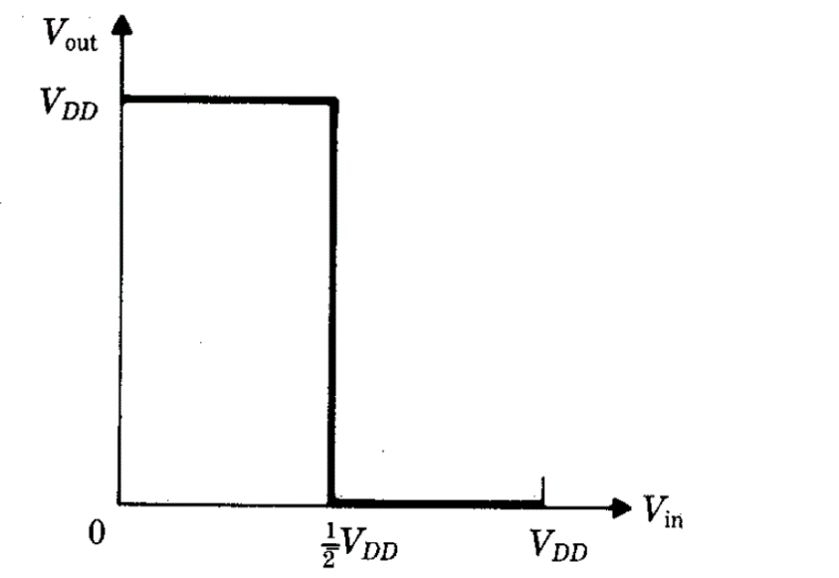
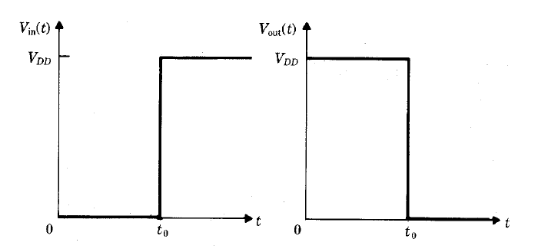
Inverter – the Not logic gate
Ideal Inverter
Voltage transfer Characteristic (VTC)
Transient response

Slide 14
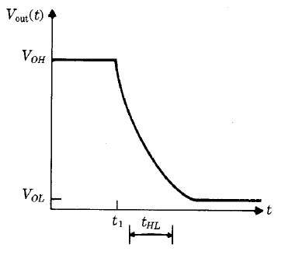
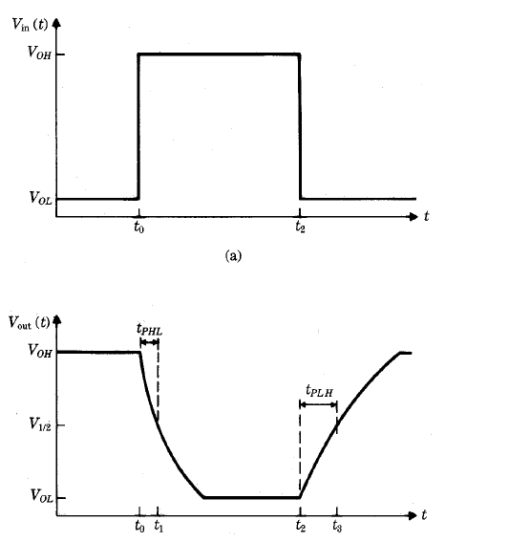
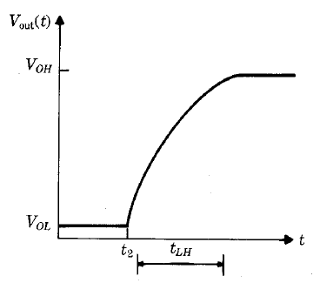
Inverter – the Not logic gate

Slide 15
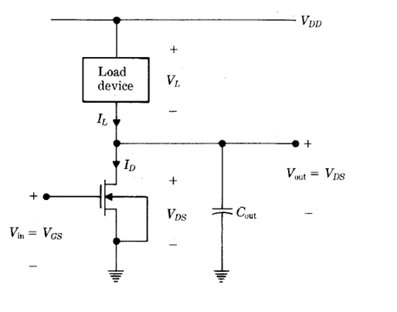
Inverter – the Not logic gate
NMOS Inverter structure
The load device can be:
Linear Resistor
Saturated n-Mos
Non-saturated n-Mos
Depletion n-Mos

Slide 16
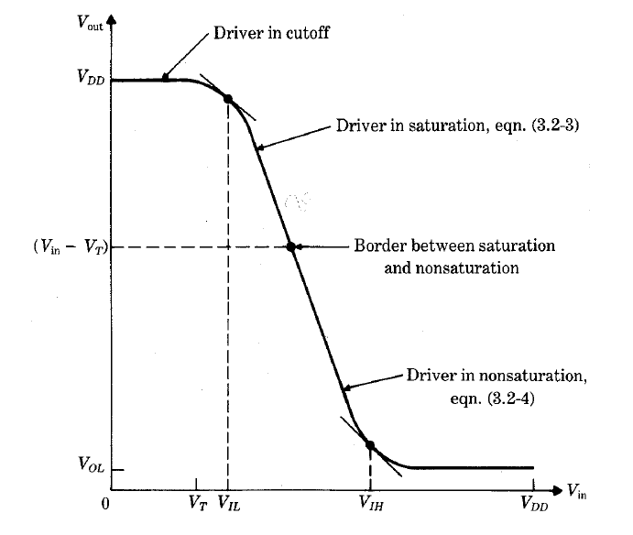
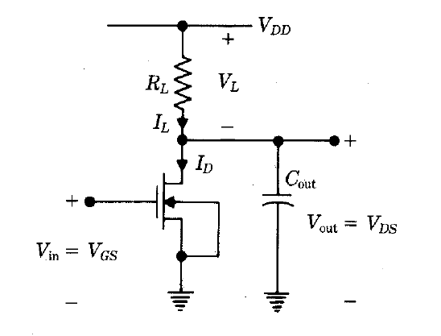

Inverter – the Not logic gate
Inverter with Linear Resistor Load
Power dissipate when nMos on

Slide 17
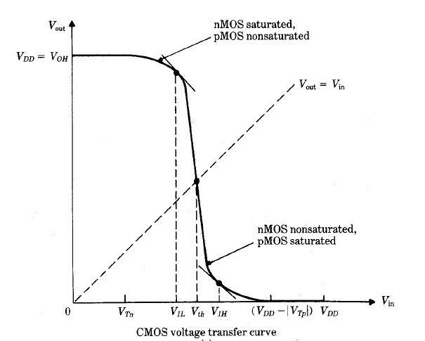
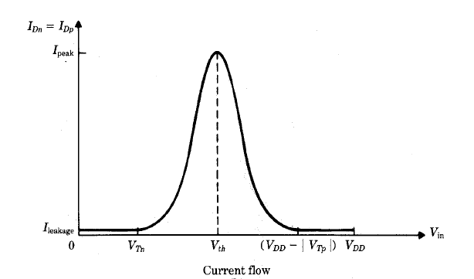
Inverter – the Not logic gate
CMOS Inverter
R
Rn
vdd
S
PMOS
G
B
Rp
Vin
in
D
out
D
Vout
G
B
vdd
NMOS
S
0.5vdd
0v
Vin

Slide 18
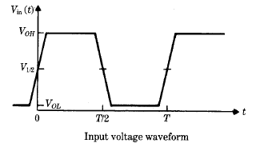
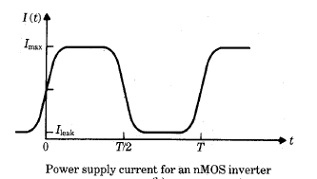
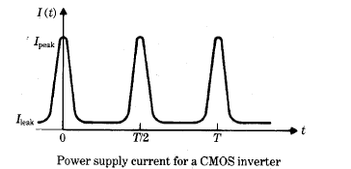
Inverter – the Not logic gate

Slide 19
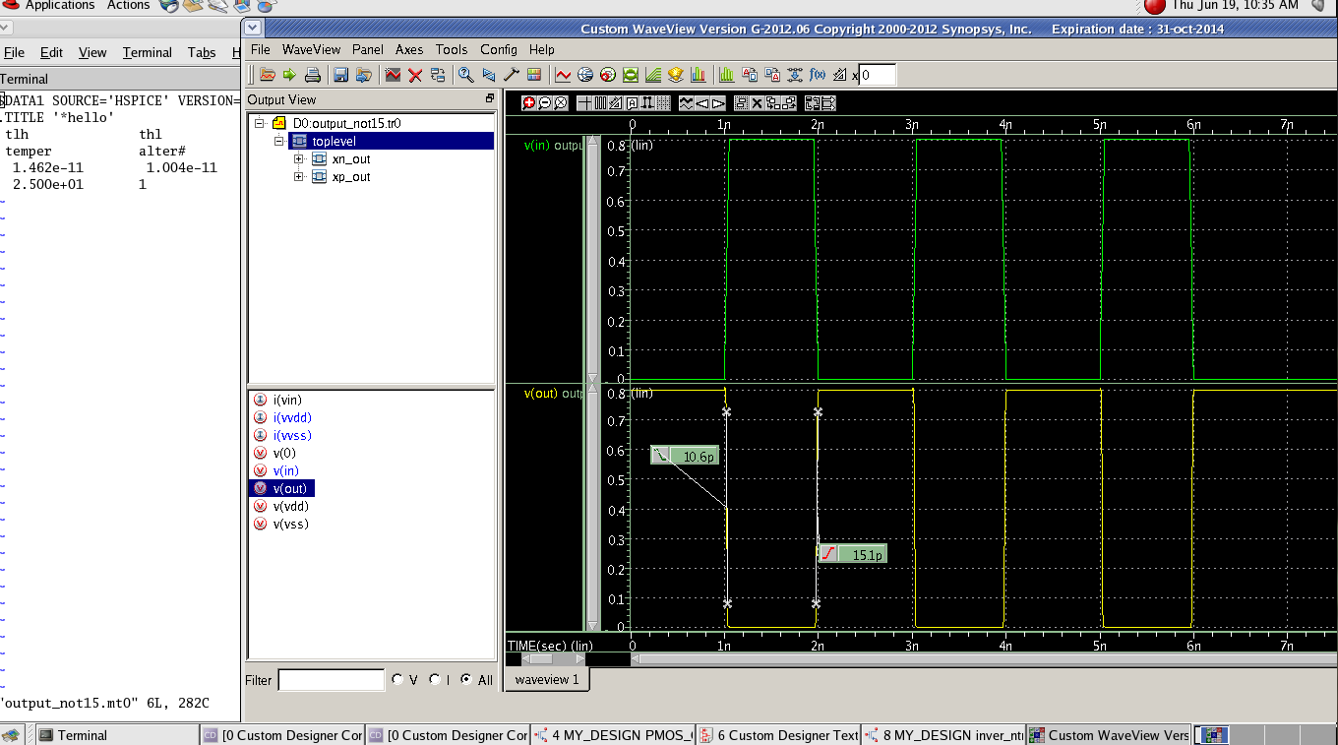
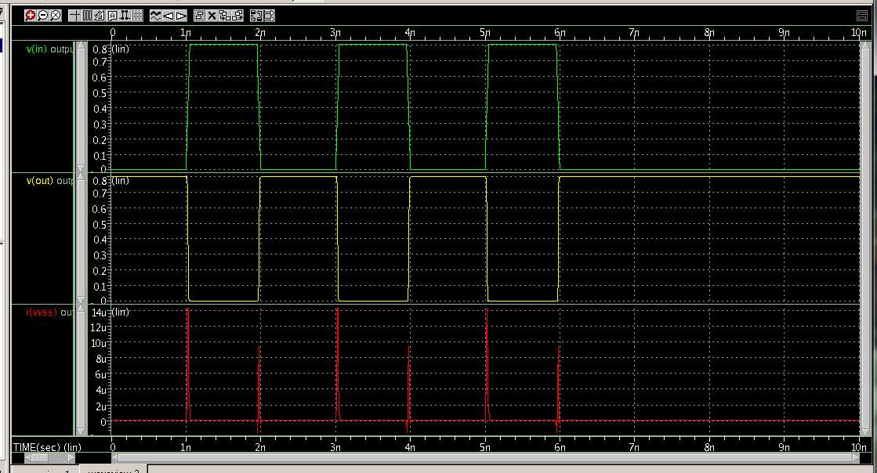
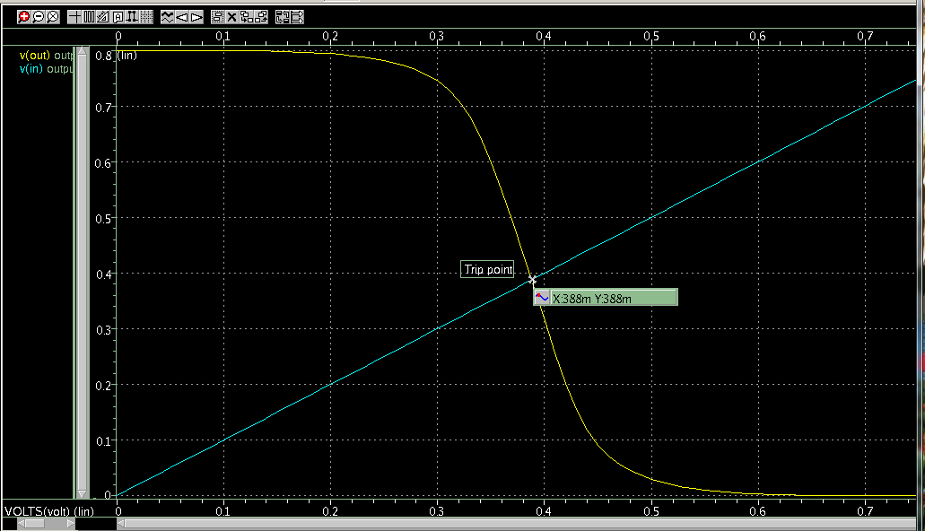
Inverter – the Not logic gate

Slide 20
Inverter – the Not logic gate
Why use CMOS
Advandtages
Disdvandtages
+ CMOS circuits dissipate power only during switching events
+ Processing is more complex than NMOS
+ Additional processing for latch-up prevention
+ VOH = VDD and VOL = 0V
+ VTC of a CMOS inverter will exhibit a sharp transition
+ CMOS require more transistors than equivalent NMOS-designs

Slide 21
Latch-up in CMOS
In
Vdd
GND
Out
Vdd
p+
n+
n+
p+
p+
n+
Q1
n-well
Rwell
Out
Q2
0
p-substrate
Q1
Q2
Noise
p+
n+
n+
p+
p+
n+
Vdd
Out
Rsub
Rsub
n
Rwell
GND
Q1
GND
Q2
p

Slide 22
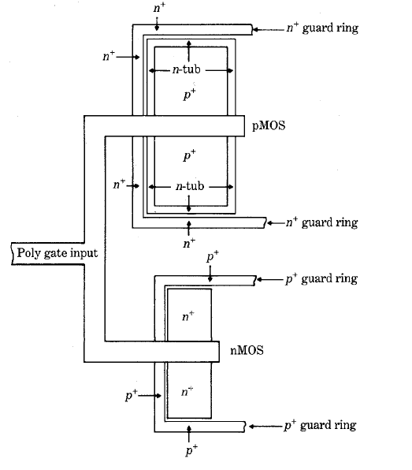
Latch-up in CMOS
Latch-up Effect

Slide 23
Others CMOS design
CMOS InverterZ
VDD
VDD
CKB
VDD
S
A
INVZ
Y
G
B
Rp0
VSS
CK
P0
Symbol
D
S
Rp1
CKB
CKB
G
B
P1
A
A
D
Y
a CMOS
circuit
Y
D
CK
G
B
Rn1
CK
N1
S
D
If [(CK=1)&(CKB=0)]
This becomes INV
Rn0
G
B
N0
If not [(CK=1)&(CKB=0)]
Output is isolated from input, this is called high Z state
S
VSS
VSS

Slide 24
Others CMOS design
CMOS TGate
CKB
P0
G
Rp
Rn
S
D
B
IN
VDD
OUT
a CMOS
circuit
VSS
B
S
D
N0
G
Req
Vin
CK
0
vdd
CKB
CKB
Rp
0: close
Rp
0: close
IN
OUT
IN
OUT
H
Rn
+
L
Rn
+
CL
CL
1: close
1: close
CK
0v
CK
0v

Slide 25
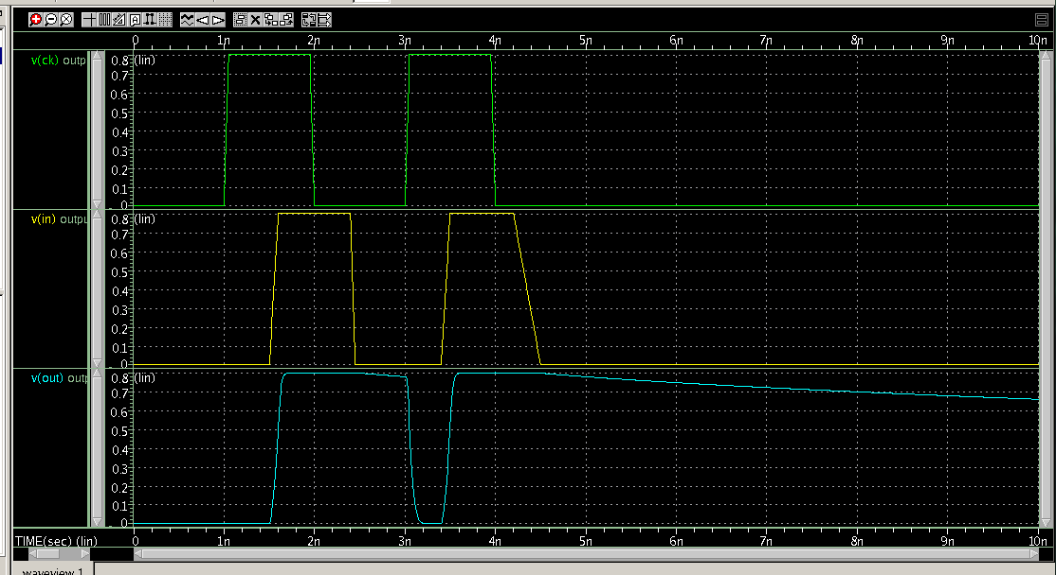
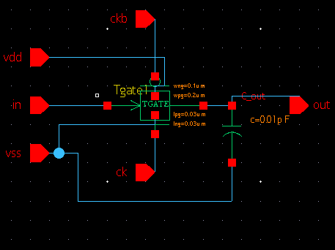
Others CMOS design
CMOS TGate

Slide 26
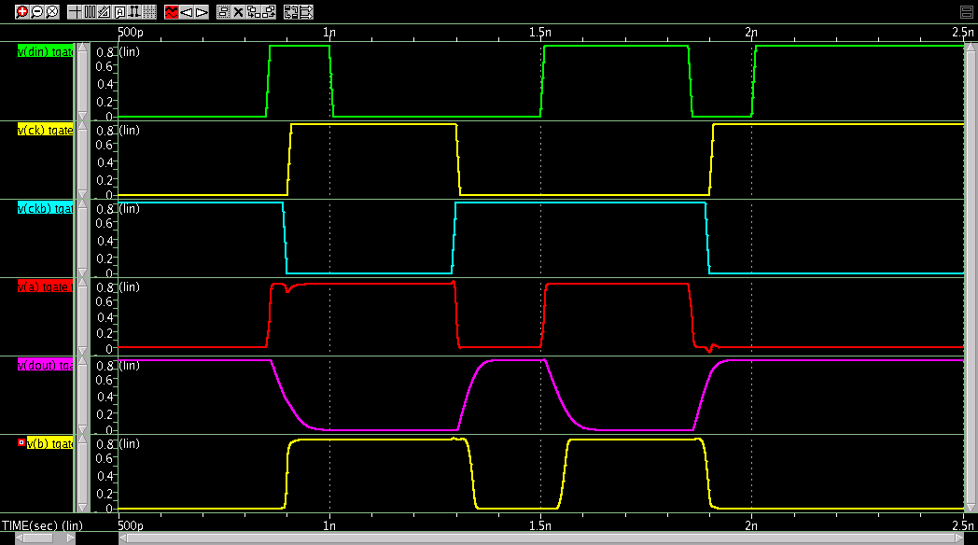
Others CMOS design
Latch Circuit
CK
CKB
Din
VDD
a
A
VDD
Y
Dout
IN
TGATE
OUT
INV
VSS
VSS
CKB
CK
VSS
b
Y
IN
VDD
OUT
A
INV
TGATE
VSS
VDD
CKB
CK
Din
CK
CKB
a
a = Din
Latch
a = Din
Latch
Dout
b

Slide 27
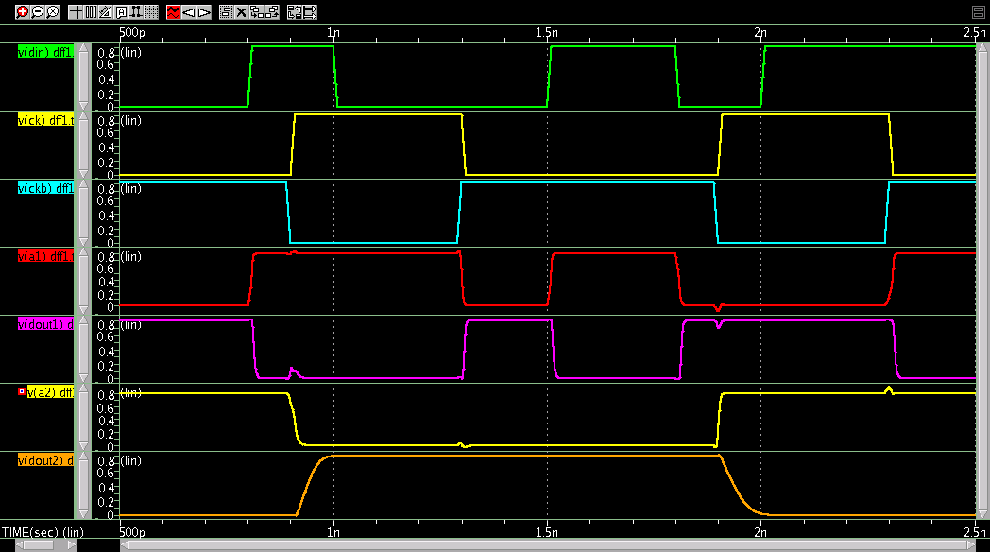
CMOS DFF using TGATE
CK
CKB
CK
Din
IN
VDD
OUT
a1
A
VDD
Y
Dout1
VSS
a2
A
VDD
Y
Dout2
TGATE
INV
IN
TGATE
OUT
INV
VSS
VSS
VDD
VSS
CKB
CKB
CK
VSS
CKB
b2
VSS
b1
Y
VDD
A
Y
IN
VDD
OUT
A
INV
TGATE
INV
TGATE
OUT
VSS
IN
VSS
VDD
VDD
CKB
CK
CK
Din
CK
CKB
a1
Latch
Latch
Dout1
a2
Latch
Latch
Dout2

Slide 28
CMOS DFF using TGATE
CK
Din
Gate1
a1
Dout1
Gate3
a2
Dout2
INV
b1
b2
Gate2
Gate4
1
CK
0
0
Gate1,4
ON
OFF
ON
Feed through may occur during this time
Gate2,3
OFF
ON
OFF
Din → Dout1
Din → Dout1
Dout1 → Dout2
Latch Dout2
Latch Dout2

Slide 29
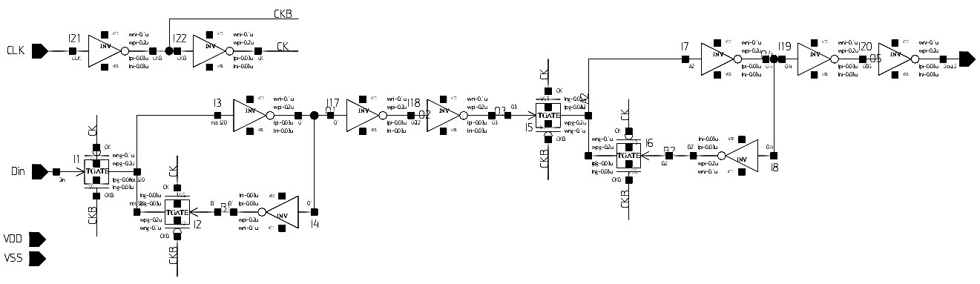
CMOS DFF using TGATE
CK
Din
Gate1
Dout1
Gate3
a1
a2
INV
Dout2
b1
b2
Gate2
Gate4
Insert buffer to prevent feed through
Create internal clock
Output buffer
Delay
Slave stage
Master stage
An example of DFF circuit

Slide 30
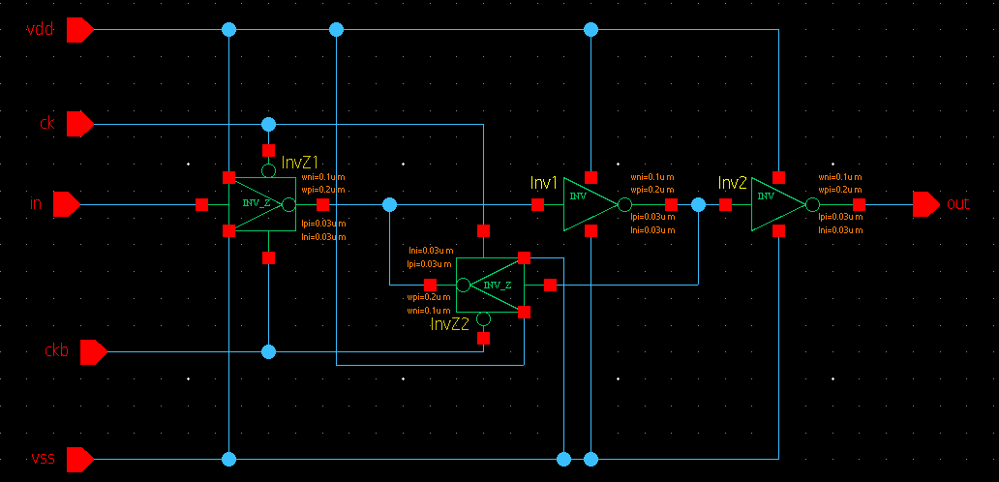
Others CMOS design
Latch - InverterZ

Slide 31
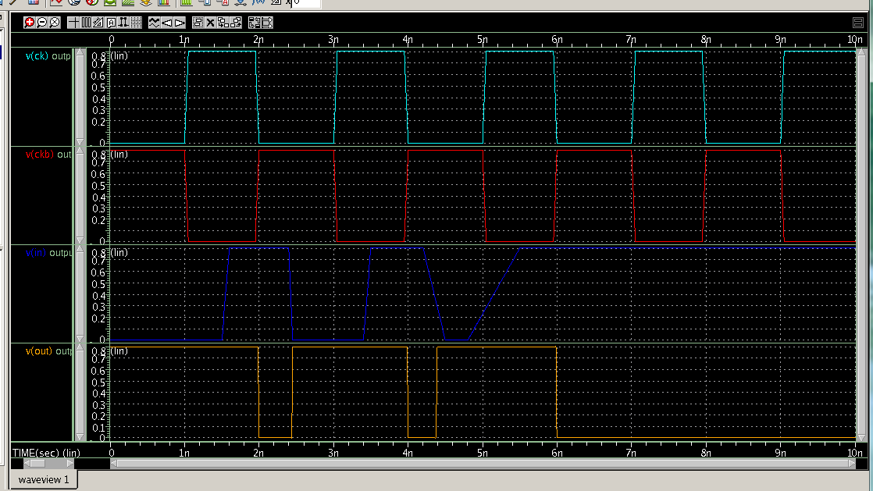
Others CMOS design
Latch - InverterZ

Slide 32
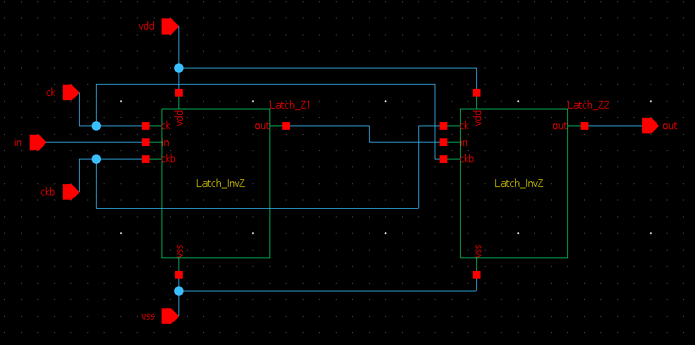
Others CMOS design
DFF InverterZ

Slide 33
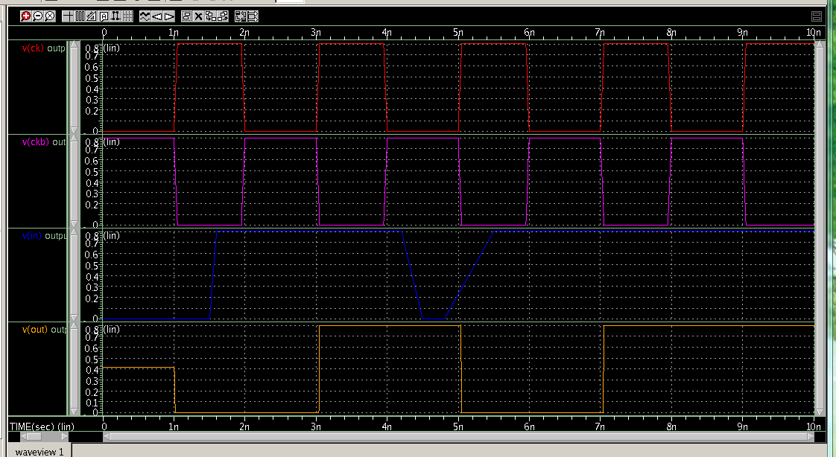
Others CMOS design
DFF InverterZ

Slide 34
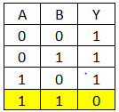
CMOS NAND gate
VDD
VDD
S
S
A
G
B
G
B
P0
P1
D
D
Y
Y
A
D
1
0
G
B
N1
S
D
B
G
B
N0
B
S
1
VSS
VSS
VDD
A
NAND
Y
Y = A.B
B
VSS
Y = 0 only one case: A = 1 and B = 1

Slide 35
CMOS NOR gate
VDD
VDD
S
B
G
B
B
P0
D
0
S
G
B
P1
Y
D
Y
1
D
D
A
A
G
B
G
B
N1
N0
0
S
S
VSS
VSS
VDD
A
Y = A+B
NOR
Y
B
Y = 0 if there is any input = 1
VSS

Slide 36
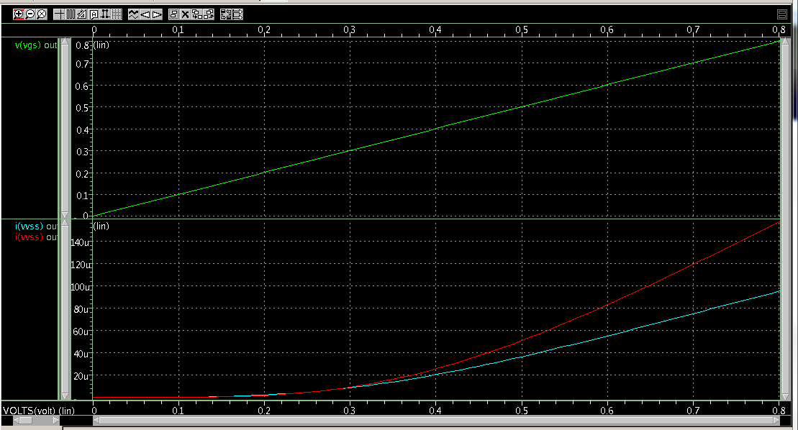
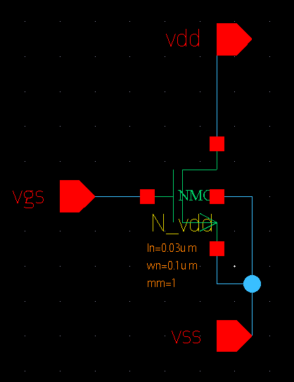
Width/Length – Voltage - Temperature
Width/Length
Design parameter
Wn = 0.2um
Width/Length – Voltage - Temperature
Wn = 0.1um

Slide 37

Width/Length – Voltage - Temperature
Depends on Cin_out and input slew
vdd
Vout
vdd
S
PMOS
Vin
G
B
in
D
out
0.5vdd
D
weaker NMOS
G
B
CL
stronger NMOS
NMOS
S
time
0v
0v
PMOS
ON
ON
OFF
NMOS
OFF
ON
ON
$$∆t$$
Longer Δt, higher power consumption

Slide 38

Width/Length – Voltage - Temperature
vdd
vdd
stronger PMOS
Vout
S
Vin
PMOS
G
B
weaker PMOS
0.5vdd
in
D
out
D
G
B
CL
time
NMOS
0v
S
0v
PMOS
OFF
ON
ON
NMOS
ON
ON
OFF
Depends on Cin_out and input slew
$$∆t$$
Longer Δt, higher power consumption

Slide 39
Width/Length – Voltage - Temperature
R
weaker PMOS
vdd
Rn
stronger NMOS
Rp
S
PMOS
G
B
Vin
in
D
out
D
Vout
G
B
vdd
NMOS
S
0v
0.5vdd
Vin

Slide 40
Width/Length – Voltage - Temperature
R
stronger PMOS
vdd
Rn
Rp
weaker NMOS
S
PMOS
G
B
Vin
in
D
out
D
Vout
G
B
vdd
NMOS
S
0v
0.5vdd
Vin

Slide 41
Width/Length – Voltage - Temperature
R
vdd
Rn
Rp
S
PMOS
G
B
Vin
in
D
out
D
Vout
G
B
vdd
NMOS
S
0v
0.5vdd
Vin
What would a designer expect?
A designer would expect Vout = 50% of vdd when Vin = 50% of vdd

Slide 42
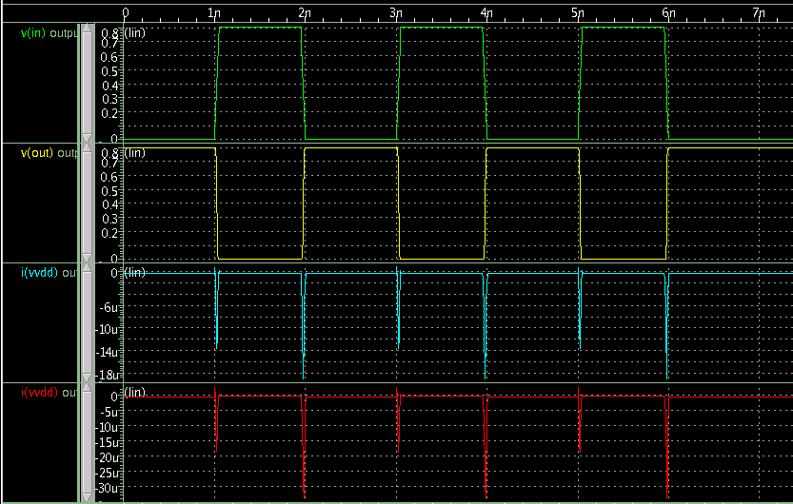
Width/Length – Voltage - Temperature
Wn = Wp
Wn = 9Wp
Effect with Inverter :
 | tpLH | tpHL
Wp = Wn | 4.351ps | 1.932ps
Wp = 2Wn | 4.012ps | 2.574ps
Wp = 3Wn | 3.674ps | 3.402ps
Wp = 4Wn | 3.395ps | 4.443ps

Slide 43
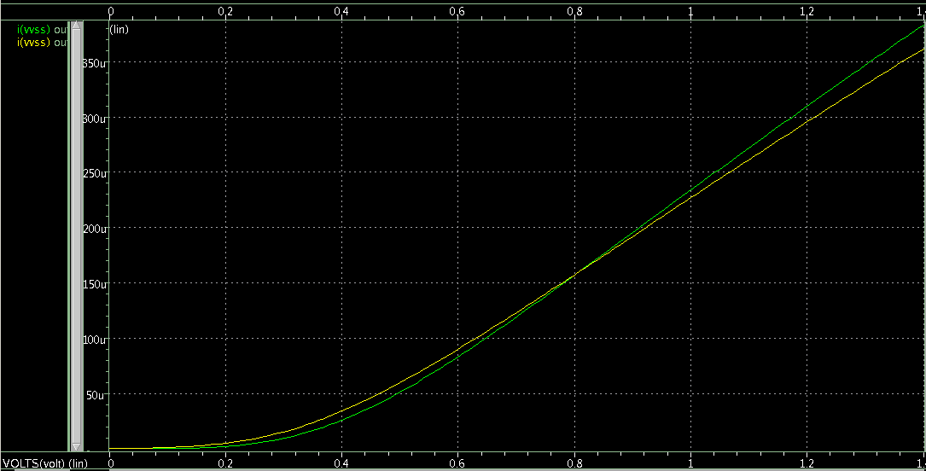
Width/Length – Voltage - Temperature
Green line : 25 ⁰C
Yellow line : 120 ⁰C
Temperature
Effect with Inverter :
 | tLH | tHL | AVG Power
-40 ºC | 10.84ps | 12.38ps | 117.4 nW
25 ºC | 12.08ps | 12.71ps | 191.5 nW
120 ºC | 13.46ps | 13.52ps | 448.0 nW_-

Slide 44
Width/Length – Voltage - Temperature
Sweep Temperature, use Transient simulation, measure time delay
tLH tHL tpLH tpHL
Temp = -4 1.157e-11 1.256e-11 4.408e-12 2.653e-12
Temp = 6 1.175e-11 1.261e-11 4.272e-12 2.616e-12
Temp = 16 1.197e-11 1.267e-11 4.102e-12 2.589e-12
Temp = 26 1.210e-11 1.272e-11 4.001e-12 2.572e-12
Temp = 36 1.225e-11 1.280e-11 3.886e-12 2.556e-12
Temp = 46 1.240e-11 1.287e-11 3.783e-12 2.547e-12
Temp = 56 1.264e-11 1.294e-11 3.690e-12 2.544e-12
Temp = 66 1.269e-11 1.302e-11 3.598e-12 2.543e-12
Temp = 76 1.288e-11 1.310e-11 3.512e-12 2.545e-12
Temp = 86 1.296e-11 1.320e-11 3.438e-12 2.548e-12
Temp = 96 1.308e-11 1.329e-11 3.366e-12 2.553e-12
Temp = 106 1.328e-11 1.339e-11 3.304e-12 2.561e-12

Slide 45
Width/Length – Voltage - Temperature
Sweep Wn, use Transient simulation, measure time delay
tLH tHL tpLH tpHL
Wn = 0.1 1.063e-11 1.084e-11 4.163e-12 2.810e-12
Wn = 0.2 1.041e-11 1.043e-11 4.639e-12 2.520e-12
Wn = 0.3 1.042e-11 1.010e-11 5.272e-12 2.007e-12
Sweep Vin, use Transient simulation, measure time delay, AVG Power
tHL tLH tpHL tpLH
Vsup = 0.9Vdd 1.160e-11 1.175e-11 4.340e-12 2.768e-12
Vsup = 0.95Vdd 1.116e-11 1.126e-11 4.258e-12 2.799e-12
Vsup = 1Vdd 1.063e-11 1.084e-11 4.163e-12 2.810e-12
Vsup = 1.05Vdd 1.028e-11 1.046e-11 4.087e-12 2.820e-12
Vsup = 1.1Vdd 9.908e-12 1.008e-11 4.014e-12 2.834e-12
Vsup = 1.15Vdd 9.572e-12 9.822e-12 3.943e-12 2.839e-12

Slide 46
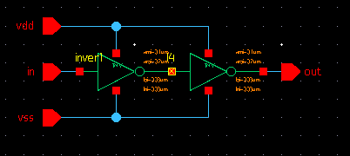
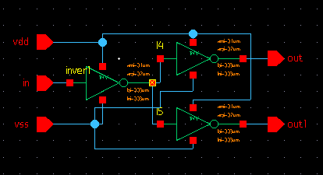
Width/Length – Voltage - Temperature
Fanout Effect
 | deLH | deHL
Driver 1 Inver | 7.593ps | 7.857ps
Driver 2 Invers | 10.37ps | 10.58ps

Slide 47
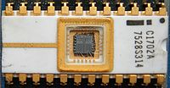


CMOS Memory

Slide 48
Part 1
Read Only Memory
ROM
Notes:
48
Slide covers the agenda of what’s to follow.

Slide 49
ROM cell array
Example: 4x4 cell array
VDD
VDD
VDD
VDD
W3
Missing contact: Bit 0
0
0
0
1
W2
One row
0
1
0
0
W1
0
1
1
0
W0
1
0
0
1
Existing contact: Bit 1
BL3
BL2
BL1
BL0
One column
Notes:
49
Slide covers the agenda of what’s to follow.

Slide 50
ROM cell array
Example: 4x4 cell array
VDD
VDD
VDD
VDD
Rp
Rp
Rp
Rp
W3
0
0
0
1
W2
0
1
0
0
W1
0
1
1
0
W0
1
0
0
1
BL3
BL2
BL1
BL0
50
Notes:
50
Slide covers the agenda of what’s to follow.

Slide 51

ROM cell array
Example: 4x4 cell array
VDD
VDD
VDD
VDD
Rp
Rp
Rp
Rp
1
W3
Rn
0
W2
Rn
0
W1
Rn
Rn
0
W0
Rn
Rn
BL3
BL2
BL1
BL0
$$Vp=\frac{Rn}{Rn+Rp}.VDD$$
VDD
VDD
VDD
0
0
0
1
Notes:
51
Slide covers the agenda of what’s to follow.

Slide 52

ROM cell array
Example: 4x4 cell array
VDD
VDD
VDD
VDD
Rp
Rp
Rp
Rp
0
W3
Rn
1
W2
Rn
0
W1
Rn
Rn
0
W0
Rn
Rn
BL3
BL2
BL1
BL0
VDD
$$Vp$$
VDD
VDD
0
1
0
0
Notes:
52
Slide covers the agenda of what’s to follow.

Slide 53
ROM cell array
Example: 4x4 cell array
VDD
VDD
VDD
VDD
Rp
Rp
Rp
Rp
0
W3
Rn
0
W2
Rn
1
W1
Rn
Rn
0
W0
Rn
Rn
BL3
BL2
BL1
BL0
VDD
$$Vp$$
$$Vp$$
VDD
0
1
1
0
Notes:
53
Slide covers the agenda of what’s to follow.

Slide 54

ROM cell array
Example: 4x4 cell array
VDD
VDD
VDD
VDD
Rp
Rp
Rp
Rp
0
W3
Rn
0
W2
Rn
0
W1
Rn
Rn
1
W0
Rn
Rn
BL3
BL2
BL1
BL0
$$Vp$$
VDD
VDD
$$Vp$$
1
0
0
1
Notes:
54
Slide covers the agenda of what’s to follow.

Slide 55



Special MOS transistor for
EPROM & EEPROM
Poly of main Gate
High Voltage
Poly of main Gate
Floating Gate
Floating Gate
S
G
D
S
G
D
SiO₂
SiO₂
n+
n+
n+
n+
p substrate
p substrate
Floating Gate MOS (FGMOS)
Programming
This transistor has been programmed, its VT is higher than Vgsmax
WL
ON
OFF
Vgsmax (in normal operation mode)
Programmed transistor will be OFF always in normal operation mode
Only non-programmed transistor can be ON/OFF in normal operation mode
Notes:
55
Slide covers the agenda of what’s to follow.

Slide 56
Special MOS transistor for
EPROM & EEPROM
Poly of main Gate
Floating Gate
Apply high voltage to Drain
S
G
D
Floating Gate of FLOTOX MOS, used for EEPROM
SiO₂
n+
n+
G
D
S
p substrate
SiO₂
Erase the data in EPROM
n+
n+
Apply violet light to the gate to release trapped electrons in the floating gate back to the substrate. This process is used to erase the EPROM before programming new data.
p substrate
Erase the data in EEPROM
Apply high voltage to the Drain of programmed transistor to release trapped electrons in the floating gate. This process is used to erase the EEPROM before programming new data.
Notes:
56
Slide covers the agenda of what’s to follow.

Slide 57
Part 2
Static Random Access Memory
SRAM
Notes:
57
Slide covers the agenda of what’s to follow.

Slide 58
SRAM cell array
WL
SRAM cell
One row
1
1
0
0
BL
BLX
One column
Two inverters connected back to back forming a bi-stable circuit, used for storing the data in the cell.
Two transistors used for connecting the cell to BL and BLX for writing/ reading operations. They are called pass-gate transistors and they are ON when the word line (WL) is HIGH
Notes:
58
Slide covers the agenda of what’s to follow.

Slide 59
SRAM Cell
Writing operation
0
OFF
1
0
OFF
1
WL
1
WL
0
0
VDD
VDD
BL
BLX
BL
BLX
1
0
0
0
1
1
GND
GND
1
0
0
1
Writing [1] into a cell which currently storing [1]
Writing [0] into a cell which currently storing [1]
Notes:
59
Slide covers the agenda of what’s to follow.

Slide 60
SRAM Cell
Reading operation
0
OFF
1
0
OFF
Turn on the Sense Amplifier to reduce reading time
0
WL
BL/BLX
1
ΔV
VDD
time
BL
BLX
WL
1
0
+ΔV
time
+
+
C_{BL}
C_{BLX}
Reading time
GND
GND
GND
Due to large BL/BLX capacitance, if we wait until BL or BLX discharges completely to read the data out, reading time is very long.
1
1
0
Sense amplifier is used to reduce reading time → speed up the speed of memory
Notes:
60
Slide covers the agenda of what’s to follow.

Slide 61
SRAM Cell
Reading operation
WL
1
VDD
BL
BLX
1
0
ΔV
+ΔV
+
+
C_{BL}
C_{BLX}
GND
GND
GND
Vp
Vp-ΔV
MEM Core
1
RBL
ΔV
0
RBLX
1
COLX
Wrong reading
YA
Vp
VDD
Vp-ΔV
SAENX
Turn on the SA
1
0
RBL
RBLX
ΔV
+
Vp-ΔV
Vp
+
C_{RBL}
0
C_{RBLX}
1
GND
SAEN
1
GND
0
GND
Notes:
61
Slide covers the agenda of what’s to follow.

Slide 62
SRAM
WL driver
WL Driver
Column 0
Column 1
Column 2
Column n-1
WL0
. . . . . . . .
SRAM
Cell
SRAM
Cell
SRAM
Cell
SRAM
Cell
WL1
SRAM
Cell
SRAM
Cell
SRAM
Cell
SRAM
Cell
WL2
SRAM
Cell
SRAM
Cell
SRAM
Cell
SRAM
Cell
. . . . . . . .
WLm-1
SRAM
Cell
SRAM
Cell
SRAM
Cell
SRAM
Cell
Notes:
62
Slide covers the agenda of what’s to follow.

Slide 63
SRAM
WL driver
WL Driver
1
2
3
. . . . . . . .
n
WLx
+
+
+
+
Due to long WL → high WL capacitance.
If the Driver is not strong enough, the signal at the end of the WL would be not high enough to turn on the cell.
n
2
3
1
time
The pulse of WL signal must be long enough to read/write the cell at the and of WL completely.
An inverter chain with optimum fan-out number is used to minimize the delay.
Notes:
63
Slide covers the agenda of what’s to follow.

Slide 64
Part 3
Content Addressable Memory
CAM
Notes:
64
Slide covers the agenda of what’s to follow.

Slide 65
Content Addressable Memory (CAM)
Content Addressable Memory is a special kind of memory!
Read operation in traditional memory:
  Input is address location of the content that we are interested in it.
  Output is the content of that address.
In CAM it is the reverse:
  Input is associated with something stored in the memory.
  Output is location where the associated content is stored.
Data out
Address in
Address out
Search key in

Slide 66

Content Addressable Memory (CAM)
CAM can be used as a search engine.
We want to find matching contents in a database or Table.
Example Routing Table
Source: http://pagiamtzis.com/cam/camintro.html

Slide 67

Content Addressable Memory (CAM)

Slide 68

Content Addressable Memory (CAM)

Slide 69

Content Addressable Memory (CAM)
The search-data word is loaded into the search-data register.
All match-lines are pre-charged to high (temporary match state).
Search line drivers broadcast the search word onto the differential search lines.
Each CAM core compares its stored bit against the bit on the corresponding search-lines.
Match-lines that have at least one missing bit, discharge to ground.
Source: K. Pagiamtzis, A. Sheikholeslami, “Content-Addressable Memory (CAM) Circuits and Architectures: A Tutorial and Survey,” IEEE J. of Solid-state circuits. March 2006

Slide 70
Content Addressable Memory (CAM)
CAM
Binary CAM (BCAM)
Ternary CAM (TCAM)
BCAM can only express ‘0’ or ‘1’
(2 values >> need only 1 memory cell ).
TCAM can express ‘0’, ‘1’, and ‘X’ (don’t care).
(3 value >> need 2 memory cells).

Slide 71
TCAM bit-cell
HBL
BL
BLX
HBLX
MWL
CWL
HL
One row
TCAM cell
TCAM cell
MWL
CWL
HL
TCAM cell
TCAM cell
One column
Notes:
71
Slide covers the agenda of what’s to follow.

Slide 72
TCAM bit-cell
One TCAM cell
BL
BLX
MWL
ICBLX
ICBL
CWL
. . . . . . .
VDD
IMBL
IMBLX
Pre-charge
HL
Encoder
MLSA
. . . . . . .
GND
HBL
HBLX
MLSA
Notes:
72
Slide covers the agenda of what’s to follow.

Slide 73
TCAM
Writing operation
BL
BLX
The data is being written into this cell
1
MWL
1
ICBLX
Writing data to a TCAM bit-cell is similar to that of SRAM
ICBL
0
CWL
. . . . . . .
VDD
IMBL
IMBLX
Pre-charge
HL
Encoder
MLSA
. . . . . . .
GND
HBL
HBLX
1
0
MLSA
Notes:
73
Slide covers the agenda of what’s to follow.

Slide 74
TCAM
Writing operation
BL
BLX
0
MWL
The data is being written into this cell
1
ICBLX
ICBL
1
CWL
. . . . . . .
VDD
0
IMBL
IMBLX
Pre-charge
HL
Encoder
MLSA
. . . . . . .
GND
HBL
HBLX
0
1
MLSA
Notes:
74
Slide covers the agenda of what’s to follow.

Slide 75
TCAM
Compare operation
1. Pre-charge HL
BL
BLX
2. Broadcast the search word onto the differential search lines
0
MWL
3. IF miss, HL will discharge to GND
1
IF match, HL will remain at pre-charge level
ICBLX
4. MLSA detects its ML that has a miss
ICBL
0
CWL
VDD
. . . . . .
0
IMBL
IMBLX
Pre-charge
HL
Encoder
MLSA
. . . . . . .
GND
HBL
HBLX
1
0
MLSA
MISS
Notes:
75
Slide covers the agenda of what’s to follow.

Slide 76
TCAM
Compare operation
1. Pre-charge HL
BL
BLX
2. Broadcast the search word onto the differential search lines
0
MWL
3. IF miss, HL will discharge to GND
1
IF match, HL will remain at pre-charge level
ICBLX
ICBL
0
CWL
. . . . . . .
VDD
0
IMBL
IMBLX
Pre-charge
HL
Encoder
MLSA
. . . . . . .
GND
HBL
HBLX
0
1
MLSA
MATCH
Notes:
76
Slide covers the agenda of what’s to follow.

Slide 77
TCAM
Compare operation
BL
BLX
0
MWL
0
ICBLX
ICBL
0
CWL
. . . . . . .
VDD
1
IMBL
IMBLX
Pre-charge
HL
Encoder
MLSA
. . . . . . .
GND
HBL
HBLX
1
0
MLSA
MATCH
Notes:
77
Slide covers the agenda of what’s to follow.

Slide 78
TCAM
Compare operation
BL
BLX
0
MWL
0
ICBLX
ICBL
0
CWL
. . . . . . .
VDD
1
IMBL
IMBLX
Pre-charge
HL
Encoder
MLSA
. . . . . . .
GND
HBL
HBLX
0
1
MLSA
MISS
Notes:
78
Slide covers the agenda of what’s to follow.

Slide 79
TCAM
Compare operation
BL
BLX
0
MWL
0
ICBLX
ICBL
0
CWL
. . . . . . .
VDD
0
IMBL
IMBLX
Pre-charge
HL
Encoder
MLSA
. . . . . . .
GND
HBL
HBLX
0
1
MLSA
MATCH ALWAYS
Notes:
79
Slide covers the agenda of what’s to follow.

Slide 80
TCAM
Compare operation
BL
BLX
0
MWL
0
ICBLX
ICBL
0
CWL
. . . . . . .
VDD
0
IMBL
IMBLX
Pre-charge
HL
Encoder
MLSA
. . . . . . .
GND
HBL
HBLX
1
0
MLSA
MATCH ALWAYS
Notes:
80
Slide covers the agenda of what’s to follow.

Slide 81
TCAM
Compare operation
BL
BLX
0
MWL
1
ICBLX
ICBL
0
CWL
. . . . . . .
VDD
1
IMBL
IMBLX
Pre-charge
HL
Encoder
MLSA
. . . . . . .
GND
HBL
HBLX
1
0
MLSA
MISS ALWAYS
Notes:
81
Slide covers the agenda of what’s to follow.

Slide 82
TCAM
Compare operation
BL
BLX
0
MWL
1
ICBLX
ICBL
0
CWL
. . . . . . .
VDD
1
IMBL
IMBLX
Pre-charge
HL
Encoder
MLSA
. . . . . . .
GND
HBL
HBLX
0
1
MLSA
MISS ALWAYS
Notes:
82
Slide covers the agenda of what’s to follow.

Slide 83
TCAM
Compare operation - Summary
Storing bit [1]
Storing bit [0]
Storing bit [X]
[0]
[1]
[0]
[1]
Mask-cell
Mask-cell
Mask-cell
Mask-cell
Don’t use
[1]
[0]
[0]
[1]
Core-cell
ML
Core-cell
ML
Core-cell
ML
Core-cell
ML
Match
Miss
Match
Miss
Compare
Compare
Compare
Compare
Search bit
Search bit
Search bit
Search bit
[1]
[1]
[X]
[X]
We can imagine that a TCAM cell can store bit [0], or bit [1], or bit [X]. The technique is using 2 SRAM cells for those. Each cell must be written independently if they share the same BL/BLX.
In case a TCAM cell stores bit [X], it matchs always with the data bit. This case is used if we don’t want to compare any specific bit in any search word, and the bit [X] can be stored at any location of the Memory cell array.
If we don’t want to compare any specific bit in all search words, bits [X] must be stored in the same column.
Notes:
83
Slide covers the agenda of what’s to follow.

Slide 84
TCAM
Compare operation - Example
HBL2
HBL2X
VDD
HBL1
HBL1X
HBL0
HBL0X
Pre-charge
ML3
MLSA
VDD
Pre-charge
ML2
A1
MLSA
VDD
Encoder
Address out
Pre-charge
A0
ML1
MLSA
VDD
Pre-charge
ML0
MLSA
TCAM cell array
Search data register/ driver/ global mask
D2
D1
D0
Search word
Notes:
84
Slide covers the agenda of what’s to follow.

Slide 85
TCAM
Compare operation - Example
HBL2
HBL2X
VDD
HBL1
HBL1X
HBL0
HBL0X
Pre-charge
ML3
(11)
MLSA
0
0
1
VDD
Pre-charge
ML2
(10)
A1
MLSA
1
0
1
1
VDD
Encoder
Address out
Pre-charge
A0
ML1
(01)
MLSA
0
1
0
0
VDD
Pre-charge
ML0
(00)
MLSA
1
1
0
The match-line on which all bits match
remains in the pre-charged-high state
0
1
1
0
1
0
Search data register/ driver/ global mask
Match-lines that have at least one bit that miss, discharge to GND. High capacitance of ML leads to long discharge time. To speed up the comparison, MLSA is used.
0
D2
1
D1
1
D0
Search word
Notes:
85
Slide covers the agenda of what’s to follow.

Slide 86
TCAM
Compare operation - Example - Global mask
HBL2
HBL2X
VDD
HBL1
HBL1X
HBL0
HBL0X
Pre-charge
ML3
(11)
MLSA
0
0
1
VDD
Pre-charge
ML2
(10)
A1
MLSA
1
0
1
1
VDD
Priority Encoder
Address out
Pre-charge
A0
ML1
(01)
MLSA
0
1
0
0
VDD
Pre-charge
ML0
(00)
MLSA
1
1
0
0
1
1
1
1
0
There could be more than one match-line on which all bits match. In this case, the encoder must be priority encoder type instead of normal encoder. Normally, lower address, higher priority.
Search data register/ driver/ global mask
0
D2
1
D1
1
D0
Search word
Notes:
86
Slide covers the agenda of what’s to follow.

Slide 87
Thank You !

